Slide 1
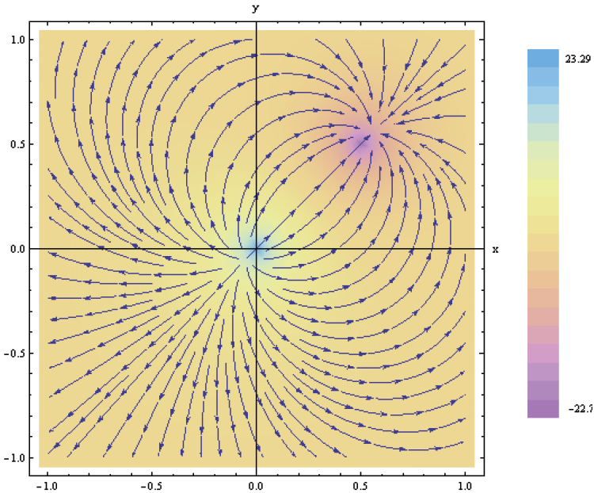
3. Vector Analysis
7e Applied EM by Ulaby and Ravaioli

Slide 2
Chapter 3 Overview

Slide 3
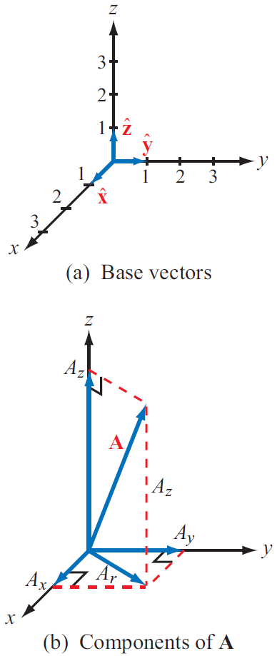
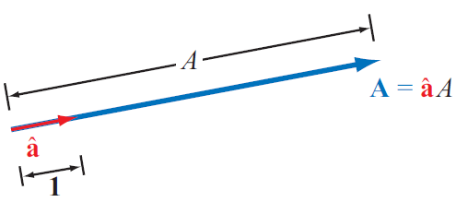
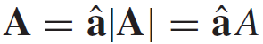
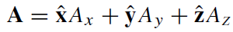
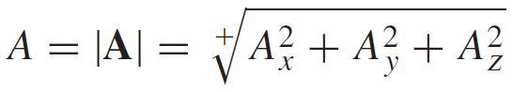
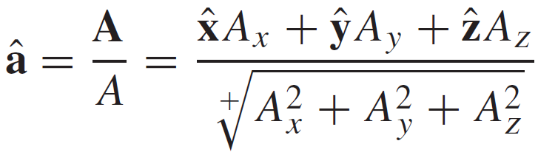
Laws of Vector Algebra
^ to represent unit vector

Slide 4
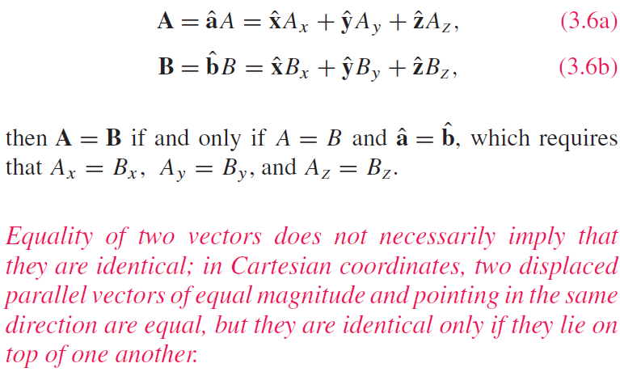
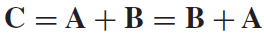
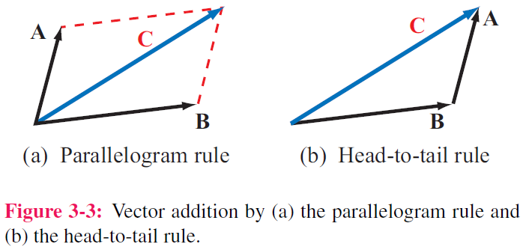
Properties of Vector Operations
Equality of Two Vectors
Commutative property
(1) Direction (2) magnitude

Slide 5
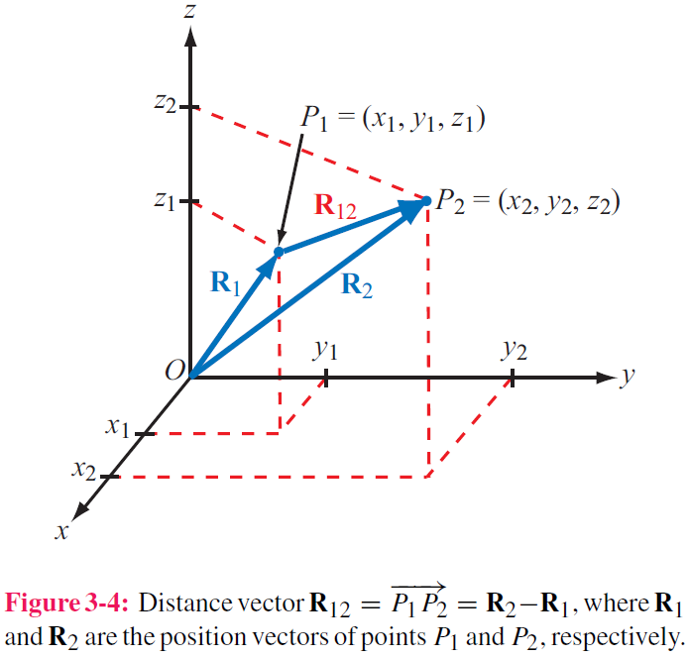
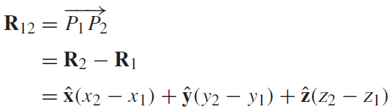
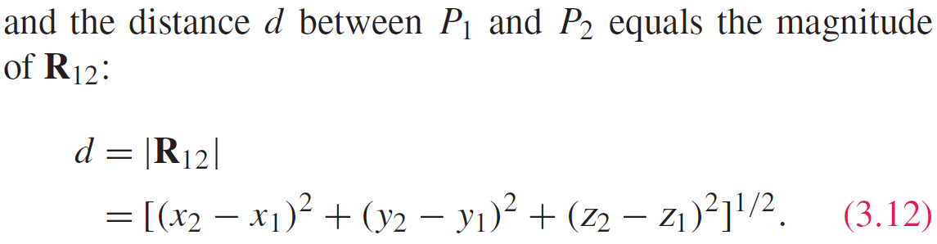
Position & Distance Vectors
Position Vector: From origin to point P
→ to represent a general vector
Distance Vector: Between two points
Subscript 1 for Starting point
Subscript 2 for ending point

Slide 6
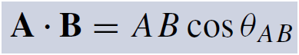
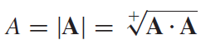
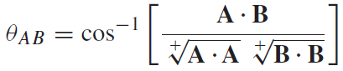
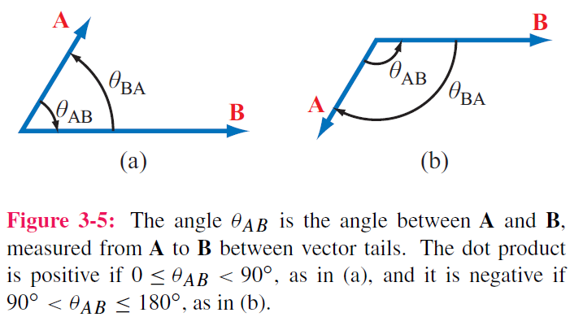
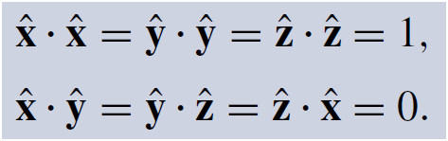
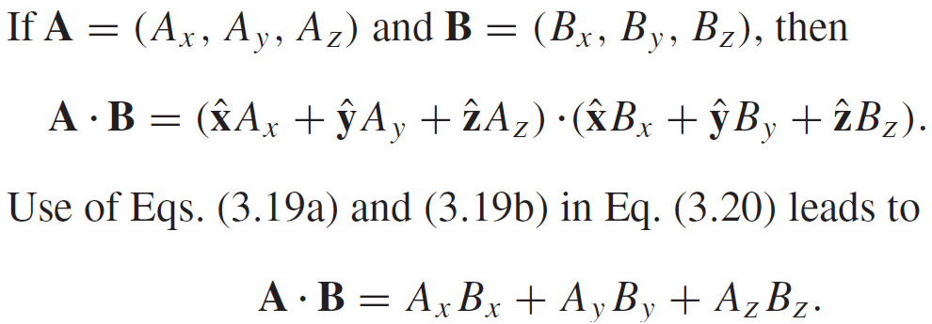
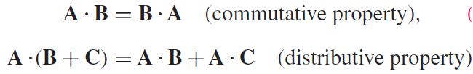
Vector Multiplication: Scalar Product or ”Dot Product”
Note the sequence
(from A to B)
Hence:

Slide 7
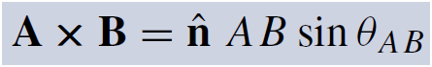
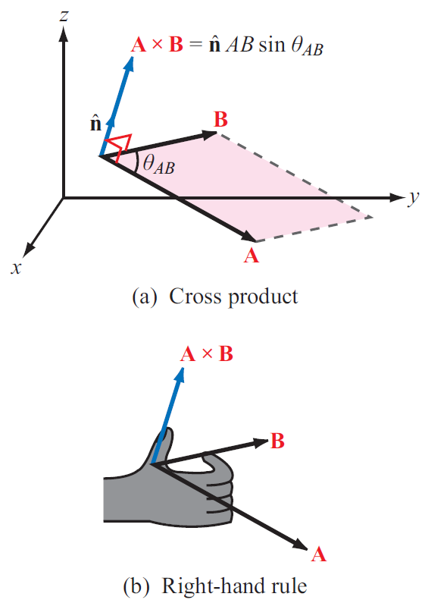
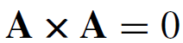
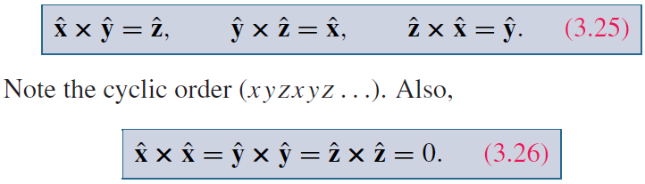
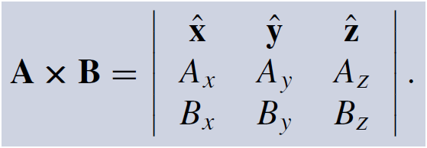
Vector Multiplication: Vector Product or ”Cross Product”
Determine direction and magnitude separately

Slide 8
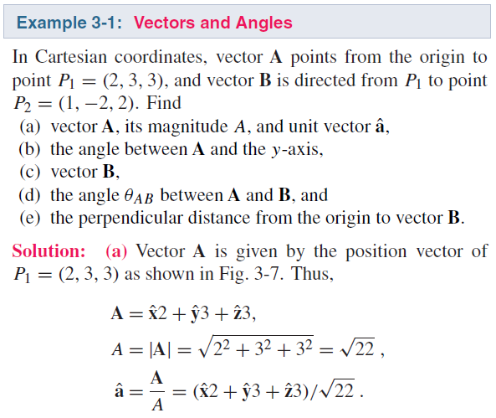
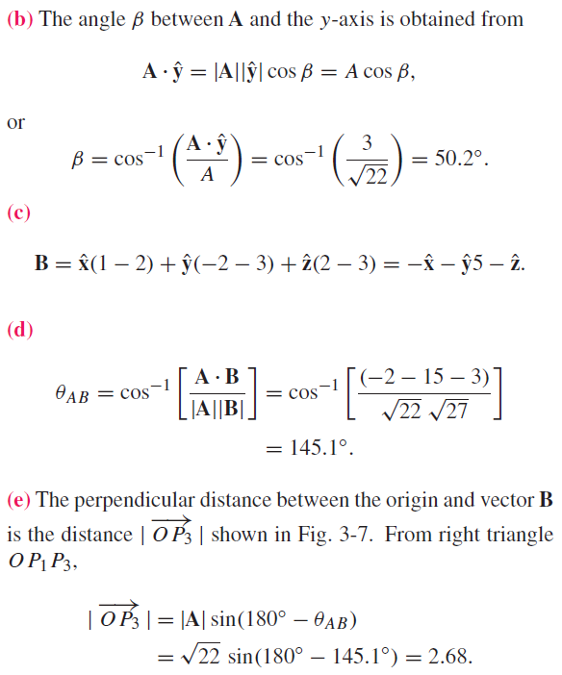
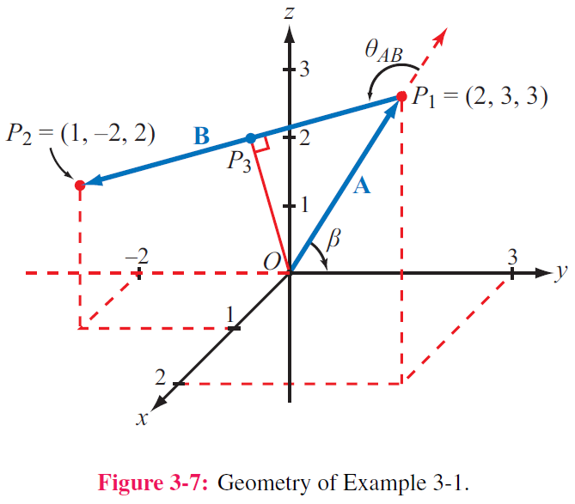

Slide 9
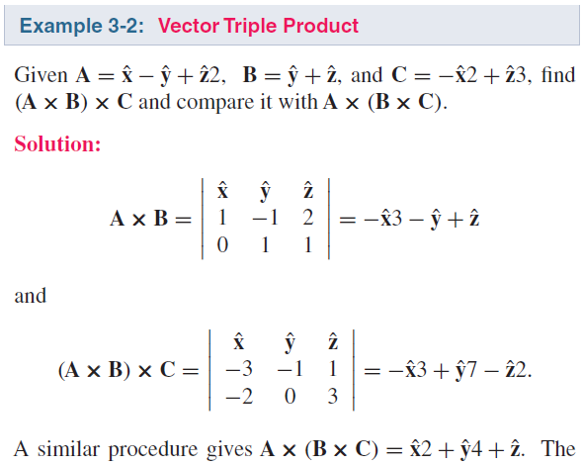
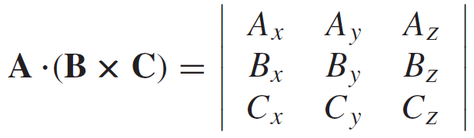
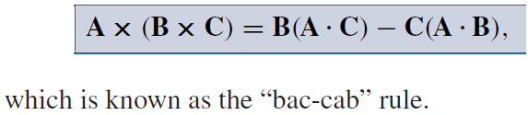
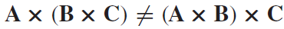
Triple Products
Scalar Triple Product
Trick: always move forward the last vector
Vector Triple Product
Hence:

Slide 10
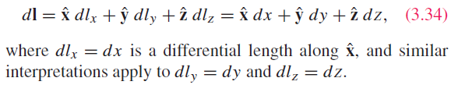
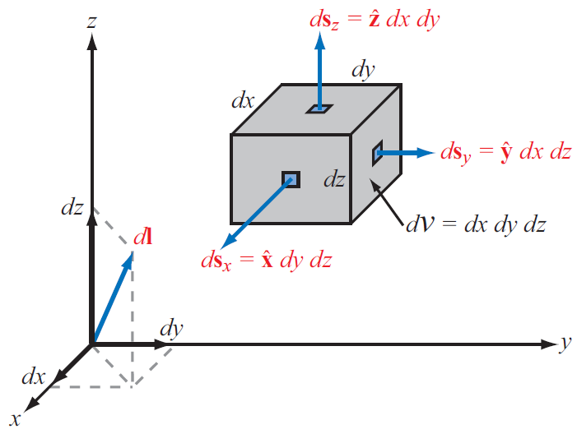
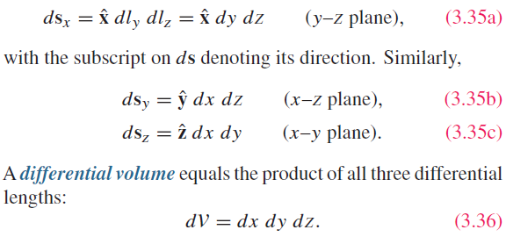
Cartesian Coordinate System
Differential length vector
Differential area vectors

Slide 11
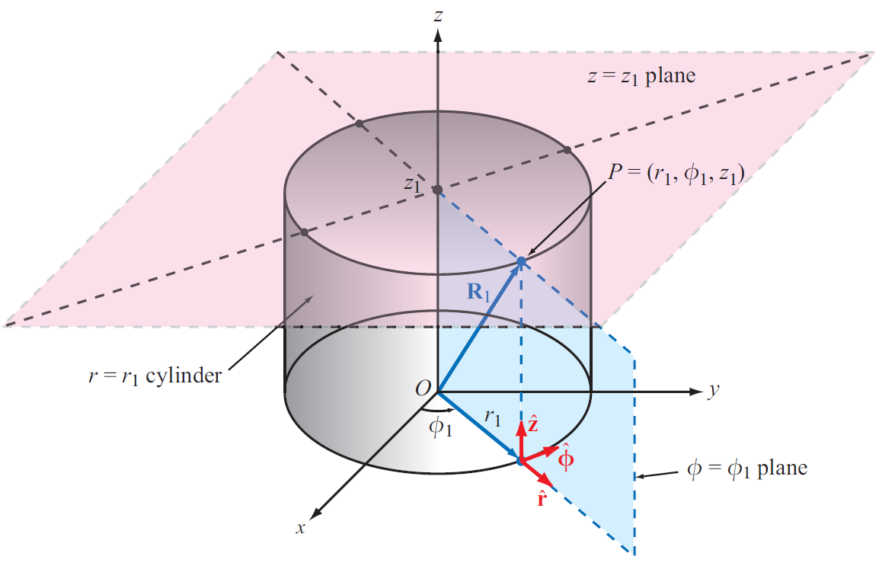
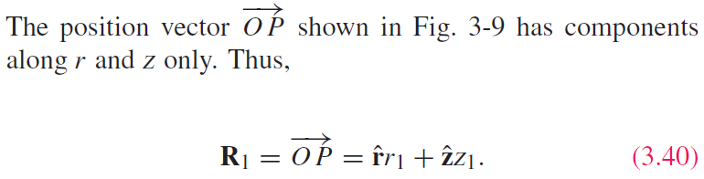
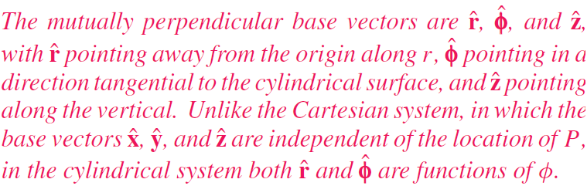
Cylindrical Coordinate System

Slide 12
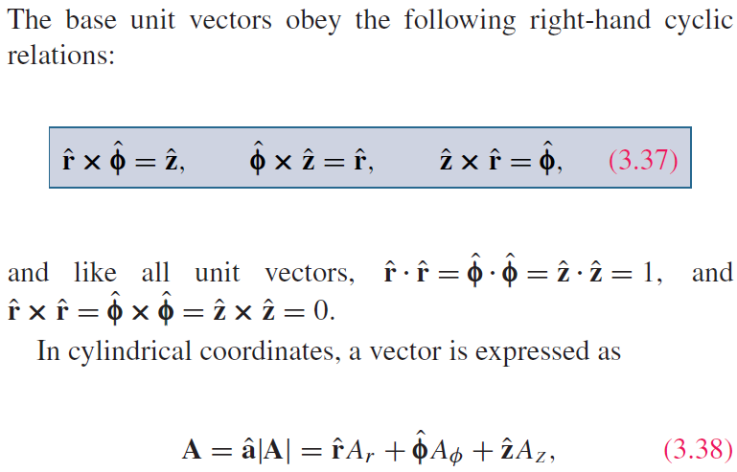
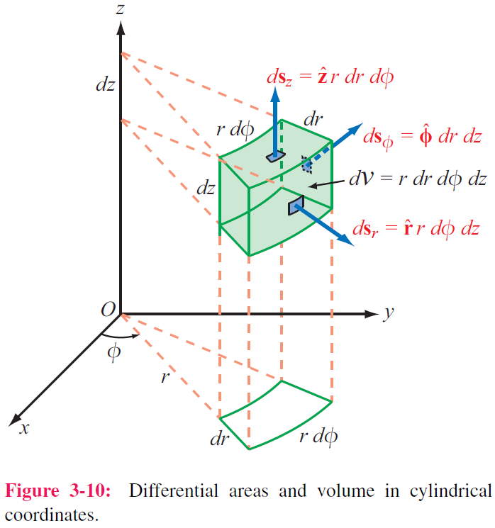
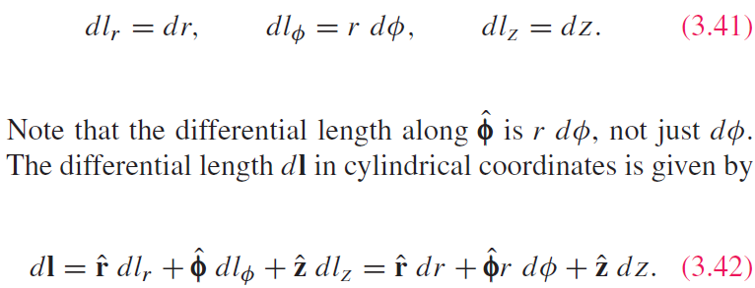
Cylindrical Coordinate System
Trick: always move forward the last vector

Slide 13
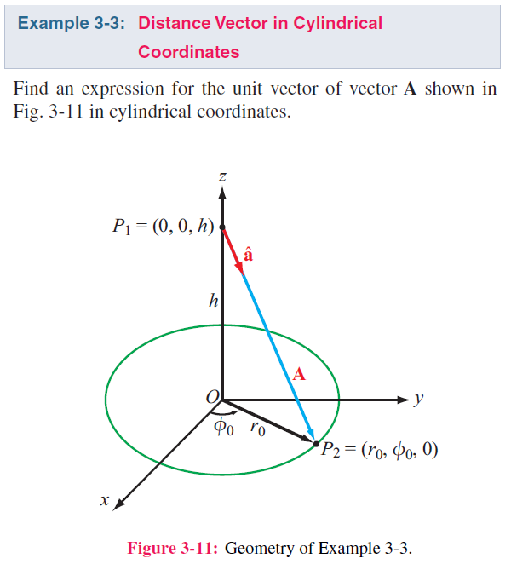
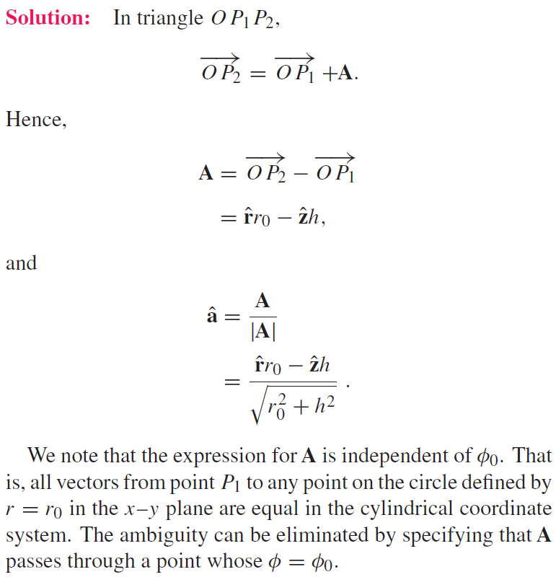

Slide 14
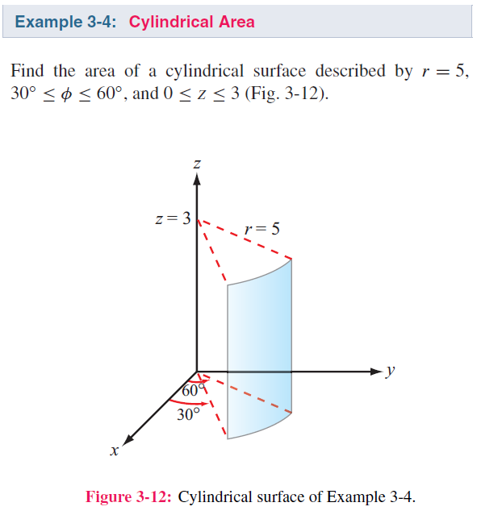
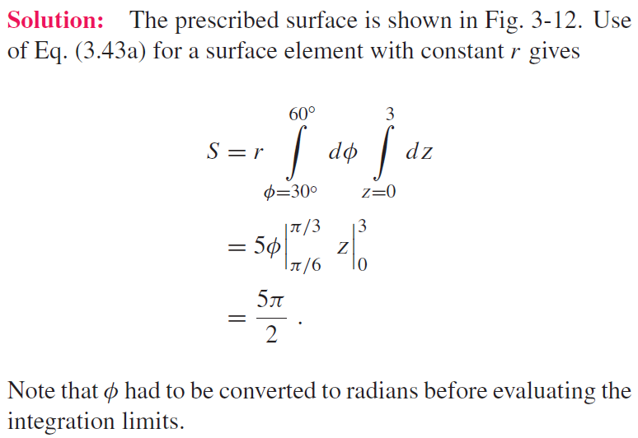

Slide 15
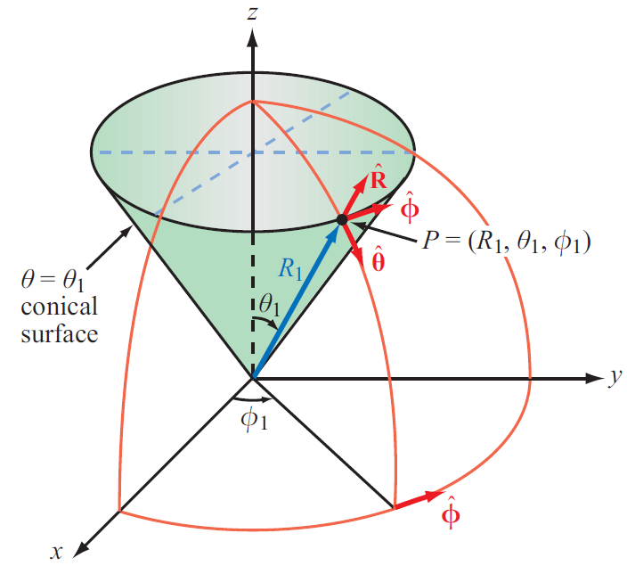
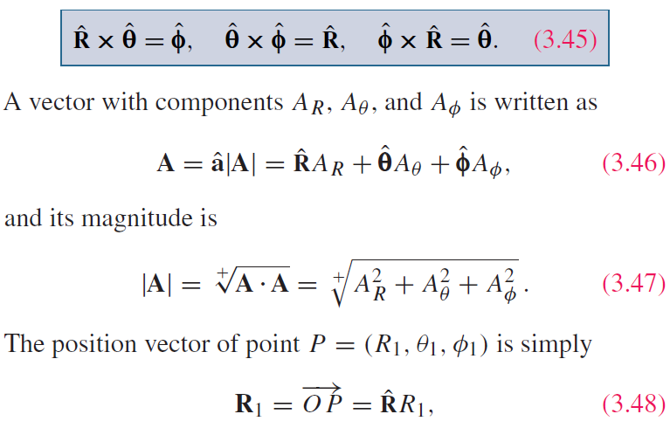
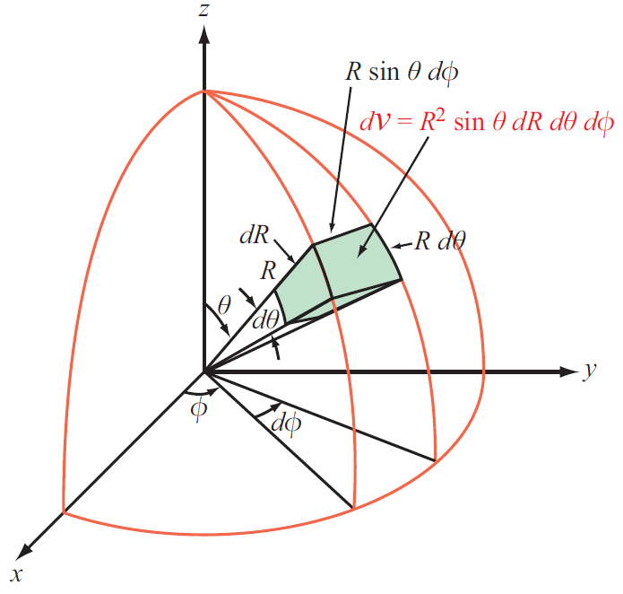
Spherical Coordinate System
Trick: always move forward the last vector

Slide 16
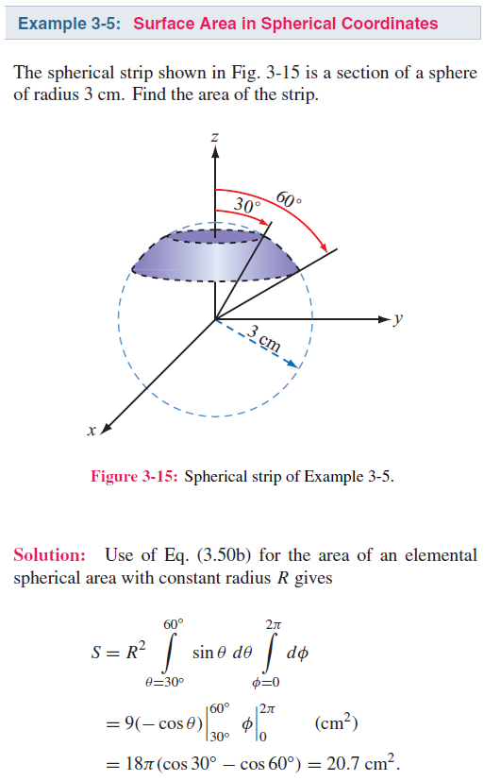
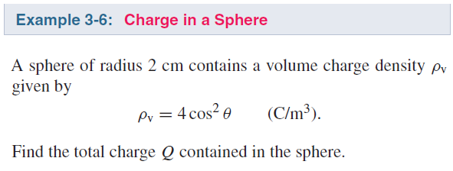


Slide 17


Slide 18

Technology Brief 5: GPS
How does a GPS receiver determine its location?

Slide 19
GPS: Three Segments
Space segment: 24 satellites (now 32) on six orbital planes at 20200 km altitude, circling Earth every 12 hours, transmitting continuous coded signals at 1.57542 and 1.22760 GHz
User segment: receivers, receiving and processing signals from multiple satellite signals, have many channels to monitor multiple satellites and distinguish them via special codes
Control segment: distributed around the world, monitoring the satellites and updating their precise orbital information

Slide 20



GPS: Minimum of 4 Satellites Needed
Unknown: location of receiver $(x_{0}, y_{0}, z_{0})$
Also unknown: time offset of receiver clock $t_{0}$
Quantities known with high precision: locations of satellites and their atomic clocks (satellites use expensive high precision clocks, whereas receivers do not)
Solving for 4 unknowns requires at least 4 equations (four satellites)

Slide 21


Coordinate Transformations: Coordinates
To solve a problem, we select the coordinate system that best fits its geometry
Sometimes we need to transform between coordinate systems

Slide 22




Coordinate Transformations: Unit Vectors

Slide 23


Slide 24


Slide 25



Using the relations:
Leads to:

Slide 26



Distance Between 2 Points

Slide 27




Gradient of A Scalar Field
Define
$$T(x,y,z)$$
Also known as: nabla operator

Slide 28





Gradient ( cont.)
$$\frac{dT}{dl}=∇T∙{\hat{a}}_{l}=\left|∇T\right|\cos{θ}$$
The directional derivative dT/dl is the projection of the gradient on ${\hat{a}}_{l}$. So the directional derivative gets its maximum value when the direction ${\hat{a}}_{l}$ is the same as the direction of the gradient. Put this in another way, the magnitude of the gradient is the maximum value of the directional derivative and the function varies fastest on its direction

Slide 29








Flux
Define flux for a vector field
Total flux flowing through the surface S
Vector field
$$A$$
$$Φ=\int{A∙dS}$$
Open surface
$$S$$
Vector field
Closed surface

Slide 30




Divergence of a Vector Field
$$divE=∇∙E=\lim_{∆V→0}{\frac{∯{E∙dS}}{∆V}}$$
$$S$$
Flux on Face 1
Flux on Face 2

Slide 31
Derivation of Divergence

Slide 32





Physical Meaning of Divergence
$$∇∙A\left(x_{0},y_{0},z_{0}\right)>0$$
$$∇∙A\left(x_{0},y_{0},z_{0}\right)<0$$
$$\left(x_{0},y_{0},z_{0}\right)$$
$$\left(x_{0},y_{0},z_{0}\right)$$

Slide 33

Divergence Theorem
Obtained from the definition of divergence
Useful tool for converting integration over a volume to one over the surface enclosing that volume, and vice versa

Slide 34



Slide 35









An Example
$$∇∙E=\frac{q}{4πε}\frac{1}{R^{2}}\frac{∂}{∂R}\left(R^{2}\frac{1}{R^{2}}\right)=0$$
$$(R≠0)$$
$$\left(∇∙E\right)V=\left|E\right|4πR^{2}=\frac{q}{ε}$$
$$∇∙E=\frac{q}{εV}=\frac{ρ_{v}}{ε}$$
$$(R=0)$$

Slide 36

Another Example
From the last example, one may consider that a vector field with only R component and only varying with R purely has nonzero divergence at R = 0. Is this true?

Slide 37




Curl of a Vector Field
Right-hand rule

Slide 38

Physical Meaning of Curl
$$∇×A\left(x_{0},y_{0},z_{0}\right)≠0$$
If curl of a vector field A at a point is not zero, this means the field A has an overall rotational feature at this point. The direction of the curl is defined by the rotation direction
(x₀, y₀, z₀)
(x₀, y₀, z₀)

Slide 39




An Example

Slide 40

Another Example
From the last example, one may consider that the location where a magnetic field can get nonzero curl is at the place with a current source. And if no source at a location, then the curl here must be 0. Is this true?

Slide 41


Stokes’s Theorem
Obtained from the definition of curl

Slide 42



Laplacian Operator
Laplacian of a Scalar Field
Laplacian of a Vector Field
Useful Relation

Slide 43




Units
How does the unit change after performing the operation of gradient, divergence and curl?
Faraday’s Law
$$\frac{V}{m}\frac{1}{m}=\frac{H}{m}\frac{A}{m}\frac{1}{s}$$
$$V=\frac{HA}{s}$$
$$Ω=\frac{H}{s}$$

Slide 44


